Slide 1


Slide 2

After completing this lesson, you should be able to do the following:
  Use the ROLLUP operation to produce
  subtotal values
  Use the CUBE operation to produce cross-tabulation values
  Use the GROUPING function to identify the row values created by ROLLUP or CUBE
  Use GROUPING SETS to produce a single result set
Notes:
Oracle Database 10g: SQL Fundamentals II 4-<number>
Objectives
In this lesson you learn how to:
Group data to obtain the following:
Subtotal values by using the ROLLUP operator
Cross-tabulation values by using the CUBE operator
Use the GROUPING function to identify the level of aggregation in the result set produced by a ROLLUP or CUBE operator
Use GROUPING SETS to produce a single result set that is equivalent to a UNION ALL approach

Slide 3

  Group functions operate on sets of rows to give one result per group.
  Example:
SELECT [column,] group_function(column). . .
FROM table
[WHERE condition]
[GROUP BY group_by_expression]
[ORDER BY column];
SELECT AVG(salary), STDDEV(salary),
COUNT(commission_pct),MAX(hire_date)
FROM employees
WHERE job_id LIKE 'SA%';
Notes:
Oracle Database 10g: SQL Fundamentals II 4-<number>
Group Functions
You can use the GROUP BY clause to divide the rows in a table into groups. You can then use group functions to return summary information for each group. Group functions can appear in select lists and in ORDER BY and HAVING clauses. The Oracle server applies the group functions to each group of rows and returns a single result row for each group.
Types of group functions: Each of the group functions AVG, SUM, MAX, MIN, COUNT, STDDEV, and VARIANCE accept one argument. The functions AVG, SUM, STDDEV, and VARIANCE operate only on numeric values. MAX and MIN can operate on numeric, character, or date data values. COUNT returns the number of non-null rows for the given expression. The example on the slide calculates the average salary, standard deviation on the salary, number of employees earning a commission, and the maximum hire date for those employees whose JOB_ID begins with SA.
Guidelines for Using Group Functions
The data types for the arguments can be CHAR, VARCHAR2, NUMBER, or DATE.
All group functions except COUNT(*) ignore null values. To substitute a value for null values, use the NVL function. COUNT returns either a number or zero.
The Oracle server implicitly sorts the result set in ascending order of the grouping columns specified, when you use a GROUP BY clause. To override this default ordering, you can use DESC in an ORDER BY clause.

Slide 4

  Syntax:
  Example:
SELECT [column,]
FROM table
[WHERE condition]
[GROUP BY group_by_expression]
[ORDER BY column];
group_function(column). . .
SELECT department_id, job_id, SUM(salary),
COUNT(employee_id)
FROM employees
GROUP BY department_id, job_id ;
Notes:
Oracle Database 10g: SQL Fundamentals II 4-<number>
Review of GROUP BY Clause
The example illustrated on the slide is evaluated by the Oracle server as follows:
The SELECT clause specifies that the following columns are to be retrieved:
Department ID and job ID columns from the EMPLOYEES table
The sum of all the salaries and the number of employees in each group that you have specified in the GROUP BY clause
The GROUP BY clause specifies how the rows should be grouped in the table. The total salary and the number of employees are calculated for each job ID within each department. The rows are grouped by department ID and then grouped by job within each department.

Slide 5

  Use the HAVING clause to specify which groups are to be displayed.
  You further restrict the groups on the basis of a limiting condition.
SELECT [column,] group_function(column)...
FROM table
[WHERE condition]
[GROUP BY group_by_expression]
[HAVING having_expression]
[ORDER BY column];
Notes:
Oracle Database 10g: SQL Fundamentals II 4-<number>
The HAVING Clause
Groups are formed and group functions are calculated before the HAVING clause is applied to the groups. The HAVING clause can precede the GROUP BY clause, but it is recommended that you place the GROUP BY clause first because it is more logical.
The Oracle server performs the following steps when you use the HAVING clause:
1. Groups rows
2. Applies the group functions to the groups and displays the groups that match the criteria in the HAVING clause

Slide 6

  Use ROLLUP or CUBE with GROUP BY to produce super aggregate rows by cross-referencing columns.
  ROLLUP grouping produces a result set containing the regular grouped rows and the subtotal values.
  CUBE grouping produces a result set containing the rows from ROLLUP and cross-tabulation rows.
Notes:
Oracle Database 10g: SQL Fundamentals II 4-<number>
GROUP BY with the ROLLUP and CUBE Operators
You specify ROLLUP and CUBE operators in the GROUP BY clause of a query. ROLLUP grouping produces a result set containing the regular grouped rows and subtotal rows. The CUBE operation in the GROUP BY clause groups the selected rows based on the values of all possible combinations of expressions in the specification and returns a single row of summary information for each group. You can use the CUBE operator to produce cross-tabulation rows.
Note: When working with ROLLUP and CUBE, make sure that the columns following the GROUP BY clause have meaningful, real-life relationships with each other; otherwise the operators return irrelevant information.

Slide 7

  ROLLUP is an extension to the GROUP BY clause.
  Use the ROLLUP operation to produce cumulative aggregates, such as subtotals.
SELECT [column,] group_function(column). . .
FROM table
[WHERE condition]
[GROUP BY [ROLLUP] group_by_expression]
[HAVING having_expression];
[ORDER BY column];
Notes:
Oracle Database 10g: SQL Fundamentals II 4-<number>
The ROLLUP Operator
The ROLLUP operator delivers aggregates and superaggregates for expressions within a GROUP BY statement. The ROLLUP operator can be used by report writers to extract statistics and summary information from result sets. The cumulative aggregates can be used in reports, charts, and graphs.
The ROLLUP operator creates groupings by moving in one direction, from right to left, along the list of columns specified in the GROUP BY clause. It then applies the aggregate function to these groupings.
Note
To produce subtotals in n dimensions (that is, n columns in the GROUP BY clause) without a ROLLUP operator, n+1 SELECT statements must be linked with UNION ALL. This makes the query execution inefficient, because each of the SELECT statements causes table access. The ROLLUP operator gathers its results with just one table access. The ROLLUP operator is useful when there are many columns involved in producing the subtotals.
Subtotals and totals are produced with ROLLUP. CUBE produces totals as well but effectively rolls up in each possible direction, producing cross-tabular data.

Slide 8

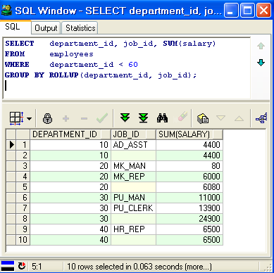
SELECT department_id, job_id, SUM(salary)
FROM employees
WHERE department_id < 60
GROUP BY ROLLUP(department_id, job_id);
Notes:
Oracle Database 10g: SQL Fundamentals II 4-<number>
Example of a ROLLUP Operator
In the example on the slide:
Total salaries for every job ID within a department for those departments whose department ID is less than 60 are displayed by the GROUP BY clause.
The ROLLUP operator displays:
Total salary for each department whose department ID is less than 60
Total salary for all departments whose department ID is less than 60, irrespective of the job IDs
In this example, 1 indicates a group totaled by both DEPARTMENT_ID and JOB_ID, 2 indicates a group totaled only by DEPARTMENT_ID, and 3 indicates the grand total.
The ROLLUP operator creates subtotals that roll up from the most detailed level to a grand total, following the grouping list specified in the GROUP BY clause. First, it calculates the standard aggregate values for the groups specified in the GROUP BY clause (in the example, the sum of salaries grouped on each job within a department). Then it creates progressively higher-level subtotals, moving from right to left through the list of grouping columns. (In the example, the sum of salaries for each department is calculated, followed by the sum of salaries for all departments.)
Given n expressions in the ROLLUP operator of the GROUP BY clause, the operation results in n + 1 (in this case 2 + 1 = 3) groupings.
Rows based on the values of the first n expressions are called rows or regular rows and the others are called superaggregate rows.

Slide 9

  CUBE is an extension to the GROUP BY clause.
  You can use the CUBE operator to produce cross-tabulation values with a single SELECT statement.
SELECT [column,] group_function(column)...
FROM table
[WHERE condition]
[GROUP BY [CUBE] group_by_expression]
[HAVING having_expression]
[ORDER BY column];
Notes:
Oracle Database 10g: SQL Fundamentals II 4-<number>
The CUBE Operator
The CUBE operator is an additional switch in the GROUP BY clause in a SELECT statement. The CUBE operator can be applied to all aggregate functions, including AVG, SUM, MAX, MIN, and COUNT. It is used to produce result sets that are typically used for cross-tabular reports. Whereas ROLLUP produces only a fraction of possible subtotal combinations, CUBE produces subtotals for all possible combinations of groupings specified in the GROUP BY clause, and a grand total.
The CUBE operator is used with an aggregate function to generate additional rows in a result set. Columns included in the GROUP BY clause are cross-referenced to produce a superset of groups. The aggregate function specified in the select list is applied to these groups to produce summary values for the additional superaggregate rows. The number of extra groups in the result set is determined by the number of columns included in the GROUP BY clause.
In fact, every possible combination of the columns or expressions in the GROUP BY clause is used to produce superaggregates. If you have n columns or expressions in the GROUP BY clause, there will be 2^{n} possible superaggregate combinations. Mathematically, these combinations form an n-dimensional cube, which is how the operator got its name.
By using application or programming tools, these superaggregate values can then be fed into charts and graphs that convey results and relationships visually and effectively.

Slide 10

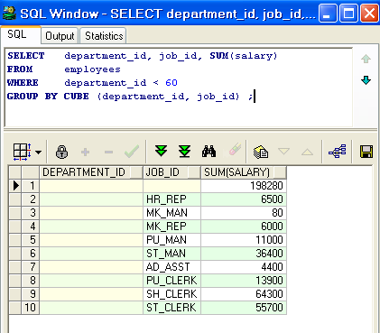
SELECT department_id, job_id, SUM(salary)
FROM employees
WHERE department_id < 60
GROUP BY CUBE (department_id, job_id) ;
Notes:
Oracle Database 10g: SQL Fundamentals II 4-<number>
Example of a CUBE Operator
The output of the SELECT statement in the example can be interpreted as follows:
The total salary for every job within a department (for those departments whose department ID is less than 60) is displayed by the GROUP BY clause.
The total salary for those departments whose department ID is less than 60.
The total salary for every job irrespective of the department.
Total salary for those departments whose department ID is less than 60, irrespective of the job titles.
In this example, 1 indicates the grand total. 2 indicates the rows totaled by JOB_ID alone. 3 indicates some of the rows totaled by DEPARTMENT_ID and JOB_ID. 4 indicates some of the rows totaled by DEPARTMENT_ID alone.
The CUBE operator has also performed the ROLLUP operation to display the subtotals for those departments whose department ID is less than 60 and the total salary for those departments whose department ID is less than 60, irrespective of the job titles. Additionally, the CUBE operator displays the total salary for every job irrespective of the department.
Note: Similar to the ROLLUP operator, producing subtotals in n dimensions (that is, n columns in the GROUP BY clause) without a CUBE operator requires that 2^{n} SELECT statements be linked with UNION ALL. Thus, a report with three dimensions requires 2³ = 8 SELECT statements to be linked with UNION ALL.

Slide 11

The GROUPING function:
  Is used with either the CUBE or ROLLUP operator
  Is used to find the groups forming the subtotal in a row
  Is used to differentiate stored NULL values from NULL values created by ROLLUP or CUBE
  Returns 0 or 1
SELECT [column,] group_function(column) .. ,
GROUPING(expr)
FROM table
[WHERE condition]
[GROUP BY [ROLLUP][CUBE] group_by_expression]
[HAVING having_expression]
[ORDER BY column];
Notes:
Oracle Database 10g: SQL Fundamentals II 4-<number>
The GROUPING Function
The GROUPING function can be used with either the CUBE or ROLLUP operator to help you understand how a summary value has been obtained.
The GROUPING function uses a single column as its argument. The expr in the GROUPING function must match one of the expressions in the GROUP BY clause. The function returns a value of 0 or 1.
The values returned by the GROUPING function are useful to:
Determine the level of aggregation of a given subtotal; that is, the group or groups on which the subtotal is based
Identify whether a NULL value in the expression column of a row of the result set indicates:
A NULL value from the base table (stored NULL value)
A NULL value created by ROLLUP or CUBE (as a result of a group function on that expression)
A value of 0 returned by the GROUPING function based on an expression indicates one of the following:
The expression has been used to calculate the aggregate value.
The NULL value in the expression column is a stored NULL value.
A value of 1 returned by the GROUPING function based on an expression indicates one of the following:
The expression has not been used to calculate the aggregate value.
The NULL value in the expression column is created by ROLLUP or CUBE as a result of grouping.

Slide 12


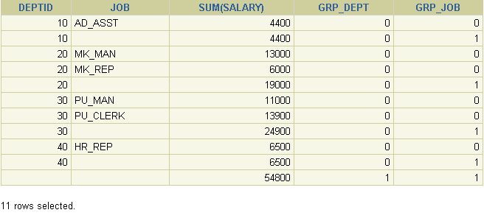


SELECT department_id DEPTID, job_id JOB,
SUM(salary),
GROUPING(department_id) GRP_DEPT,
GROUPING(job_id) GRP_JOB
FROM employees
WHERE department_id < 50
GROUP BY ROLLUP(department_id, job_id);
1
2
3
Notes:
Oracle Database 10g: SQL Fundamentals II 4-<number>
Example of a GROUPING Function
In the example on the slide, consider the summary value 4400 in the first row (labeled 1). This summary value is the total salary for the job ID of AD_ASST within department 10. To calculate this summary value, both the DEPARTMENT_ID and JOB_ID columns have been taken into account. Thus, a value of 0 is returned for both the GROUPING(department_id) and GROUPING(job_id)expressions.
Consider the summary value 4400 in the second row (labeled 2). This value is the total salary for department 10 and has been calculated by taking into account the DEPARTMENT_ID column; thus, a value of 0 has been returned by GROUPING(department_id). Because the JOB_ID column has not been taken into account to calculate this value, a value of 1 has been returned for GROUPING(job_id). You can observe similar output in the fifth row.
In the last row, consider the summary value 54800 (labeled 3). This is the total salary for those departments whose department ID is less than 50 and all job titles. To calculate this summary value, neither of the DEPARTMENT_ID and JOB_ID columns have been taken into account. Thus a value of 1 is returned for both the GROUPING(department_id) and GROUPING(job_id)expressions.

Slide 13
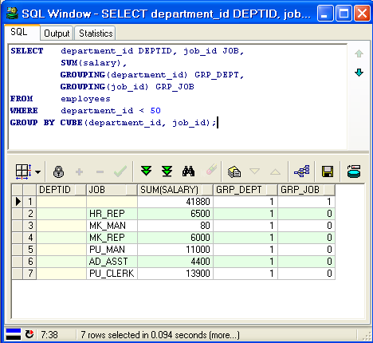
GROUPING Function: Example

Slide 14

  GROUPING SETS syntax is used to define multiple groupings in the same query.
  All groupings specified in the GROUPING SETS clause are computed and the results of individual groupings are combined with a UNION ALL operation.
  Grouping set efficiency:
    Only one pass over the base table is required.
    There is no need to write complex UNION statements.
    The more elements GROUPING SETS has, the greater the performance benefit.
Notes:
Oracle Database 10g: SQL Fundamentals II 4-<number>
GROUPING SETS
GROUPING SETS is a further extension of the GROUP BY clause that you can use to specify multiple groupings of data. Doing so facilitates efficient aggregation and, therefore, facilitates analysis of data across multiple dimensions.
A single SELECT statement can now be written using GROUPING SETS to specify various groupings (which can also include ROLLUP or CUBE operators), rather than multiple SELECT statements combined by UNION ALL operators. For example:
SELECT department_id, job_id, manager_id, AVG(salary)
FROM employees
GROUP BY
GROUPING SETS
((department_id, job_id, manager_id),
(department_id, manager_id),(job_id, manager_id));
This statement calculates aggregates over three groupings:
(department_id, job_id, manager_id), (department_id, manager_id)and (job_id, manager_id)
Without this feature, multiple queries combined together with UNION ALL are required to obtain the output of the preceding SELECT statement. A multiquery approach is inefficient, because it requires multiple scans of the same data.

Slide 15

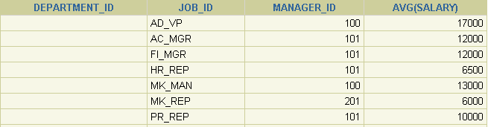

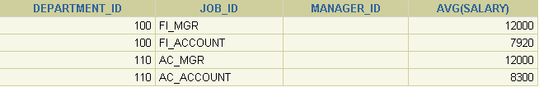

SELECT department_id, job_id,
manager_id,avg(salary)
FROM employees
GROUP BY GROUPING SETS
((department_id,job_id), (job_id,manager_id));
1
…
2
…
Notes:
Oracle Database 10g: SQL Fundamentals II 4-<number>
GROUPING SETS: Example
The query on the slide calculates aggregates over two groupings. The table is divided into the following groups:
Job ID, Manager ID
Department ID, Job ID
The average salaries for each of these groups are calculated. The result set displays the average salary for each of the two groups.
In the output, the group marked as 1 can be interpreted as:
The average salary of all employees with the job ID AD_VP under manager 100 is 17000.
The average salary of all employees with the job ID AC_MGR under manager 101 is 12000, and so on.
The group marked as 2 in the output is interpreted as:
The average salary of all employees with the job ID FI_MGR in department 100 is 12000.
The average salary of all employees with the job ID FI_ACCOUNT in department 100 is 7920, and so on.

Slide 16

  A composite column is a collection of columns that are treated as a unit.
    ROLLUP (a, , d)
  Use parentheses within the GROUP BY clause to group columns, so that they are treated as a unit while computing ROLLUP or CUBE operations.
  When used with ROLLUP or CUBE, composite columns would require skipping aggregation across certain levels.
(b,c)
Notes:
Oracle Database 10g: SQL Fundamentals II 4-<number>
Composite Columns
A composite column is a collection of columns that are treated as a unit during the computation of groupings. You specify the columns in parentheses as in the following statement:
ROLLUP (a, (b, c), d)
Here, (b,c) forms a composite column and is treated as a unit. In general, composite columns are useful in ROLLUP, CUBE, and GROUPING SETS. For example, in CUBE or ROLLUP, composite columns would require skipping aggregation across certain levels.
That is, GROUP BY ROLLUP(a, (b, c))is equivalent to
GROUP BY a, b, c UNION ALL
GROUP BY a UNION ALL
GROUP BY ()
Here, (b, c) is treated as a unit and ROLLUP is not applied across (b, c). It is as if you have an alias, for example z, for (b, c), and the GROUP BY expression reduces to
GROUP BY ROLLUP(a, z).
Note: GROUP BY( ) is typically a SELECT statement with NULL values for the columns a and b and only the aggregate function. This is generally used for generating grand totals.
SELECT NULL, NULL, aggregate_col
FROM <table_name>
GROUP BY ( );

Slide 17


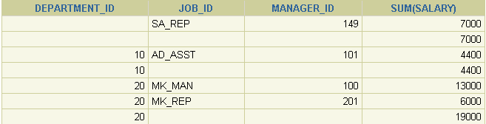

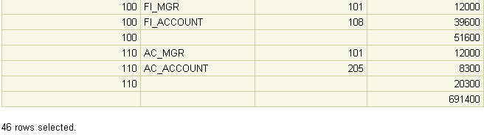


SELECT department_id, job_id, manager_id,
SUM(salary)
FROM employees
GROUP BY ROLLUP( department_id,(job_id, manager_id));
1
2
…
3
4
Notes:
Oracle Database 10g: SQL Fundamentals II 4-<number>
Composite Columns: Example
Consider the example:
SELECT department_id, job_id,manager_id, SUM(salary)
FROM employees
GROUP BY ROLLUP( department_id,job_id, manager_id);
This query results in the Oracle server computing the following groupings:
1. (job_id, manager_id)
2. (department_id, job_id, manager_id)
3. (department_id)
4. Grand total
If you are only interested in specific groups, you cannot limit the calculation to those groupings without using composite columns. With composite columns, this is possible by treating JOB_ID and MANAGER_ID columns as a single unit while rolling up. Columns enclosed in parentheses are treated as a unit while computing ROLLUP and CUBE. This is illustrated in the example on the slide. By enclosing the JOB_ID and MANAGER_ID columns in parentheses, you indicate to the Oracle server to treat JOB_ID and MANAGER_ID as a single unit, that is a composite column.

Slide 18

  Concatenated groupings offer a concise way to generate useful combinations of groupings.
  To specify concatenated grouping sets, you separate multiple grouping sets, ROLLUP, and CUBE operations with commas so that the Oracle server combines them into a single GROUP BY clause.
  The result is a cross-product of groupings from each grouping set.
  GROUP BY GROUPING SETS(a, b), GROUPING SETS(c, d)
Notes:
Oracle Database 10g: SQL Fundamentals II 4-<number>
Concatenated Columns
Concatenated groupings offer a concise way to generate useful combinations of groupings. The concatenated groupings are specified by listing multiple grouping sets, cubes, and rollups, and separating them with commas. The following is an example of concatenated grouping sets:
GROUP BY GROUPING SETS(a, b), GROUPING SETS(c, d)
This SQL example defines the following groupings:
(a, c), (a, d), (b, c), (b, d)
Concatenation of grouping sets is very helpful for these reasons:
Ease of query development: You need not manually enumerate all groupings.
Use by applications: SQL generated by OLAP applications often involves concatenation of grouping sets, with each grouping set defining groupings needed for a dimension.

Slide 19


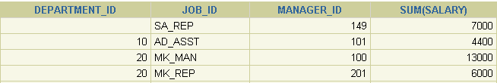


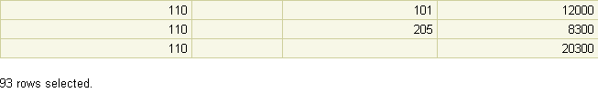


SELECT department_id, job_id, manager_id,
SUM(salary)
FROM employees
GROUP BY department_id,
ROLLUP(job_id),
CUBE(manager_id);
1
…
2
…
3
…
4
5
Notes:
Oracle Database 10g: SQL Fundamentals II 4-<number>
Concatenated Groupings: Example
The example on the slide results in the following groupings:
(job_id, manager_id) (1)
(department_id,job_id, manager_id) (2)
(job_id)(3)
(department_id,manager_id)(4)
(department_id) (5)
The total salary for each of these groups is calculated.

Slide 20

In this lesson, you should have learned how to use the:
  ROLLUP operation to produce subtotal values
  CUBE operation to produce cross-tabulation values
  GROUPING function to identify the row values created by ROLLUP or CUBE
  GROUPING SETS syntax to define multiple groupings in the same query
  GROUP BY clause to combine expressions in various ways:
    Composite columns
    Concatenated grouping sets
Notes:
Oracle Database 10g: SQL Fundamentals II 4-<number>
Summary
ROLLUP and CUBE are extensions of the GROUP BY clause.
ROLLUP is used to display subtotal and grand total values.
CUBE is used to display cross-tabulation values.
The GROUPING function enables you to determine whether a row is an aggregate produced by a CUBE or ROLLUP operator.
With the GROUPING SETS syntax, you can define multiple groupings in the same query. GROUP BY computes all the groupings specified and combines them with UNION ALL.
Within the GROUP BY clause, you can combine expressions in various ways:
To specify composite columns, you group columns within parentheses so that the Oracle server treats them as a unit while computing ROLLUP or CUBE operations.
To specify concatenated grouping sets, you separate multiple grouping sets, ROLLUP, and CUBE operations with commas so that the Oracle server combines them into a single GROUP BY clause. The result is a cross-product of groupings from each grouping set.

Slide 21

1-Write a query to display the following for those employees whose manager ID is less than 120:
- Manager ID
- Job ID and total salary for every job ID for employees who report to the same
manager
- Total salary of those managers
Total salary of those managers, irrespective of the job IDs
2-Observe the output from question 1. Write a query using the GROUPING function to determine whether the NULL values in the columns corresponding to the GROUP BY expressions are caused by the ROLLUP operation.
Notes:
Oracle Database 10g: SQL Fundamentals II 4-<number>
Practice 4: Overview
In this practice, you use the ROLLUP and CUBE operators as extensions of the GROUP BY clause. You will also use GROUPING SETS.

Slide 22
Practice :
3-Write a query to display the following for those employees whose manager ID is less than 120:
- Manager ID
- Job and total salaries for every job for employees who report to the same manager
- Total salary of those managers
- Cross-tabulation values to display the total salary for every job, irrespective of the
manager
Total salary irrespective of all job titles
4-Using GROUPING SETS, write a query to display the following groupings:
- department_id, manager_id, job_id
- department_id, job_id
- manager_id, job_id
The query should calculate the sum of the salaries for each of these groups.

